Slide 1

What Signals an Economic Downturn?
By: Benjamin Aubry, Bruce Mark, and Gary Fisher

Slide 2
Every day, trillions of dollars are traded around the world by both humans and computers. The common goal between all parties involved is to make a profit on their respective trading strategies. Even though many different types of investors exist, there is a common question that each desires to find the answer to: When should I buy, hold, or sell my investment?
Our team’s goal for this project is to determine potential sell signals by analyzing different securities’ data sets, while comparing to the overall markets.
We are looking to find potential economic and financial measurements that can be used to predetermine a recession or selloff in the US financial system.

Slide 3
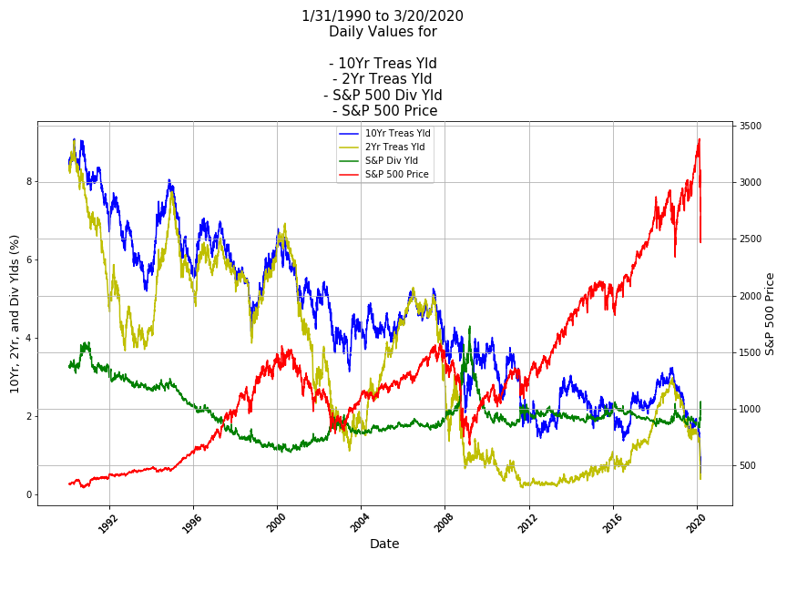

Slide 4
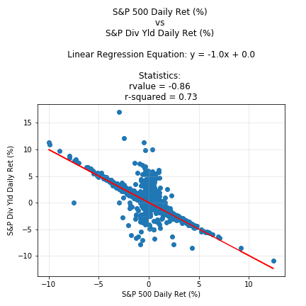
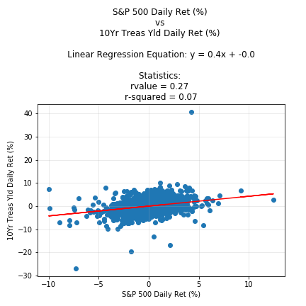
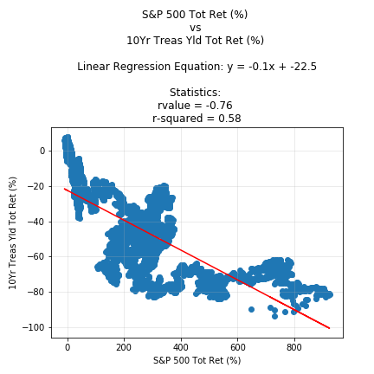
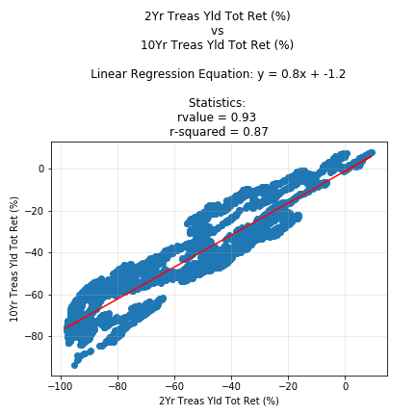

Slide 5
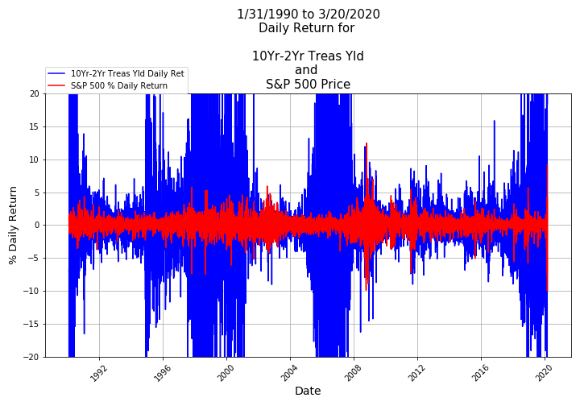
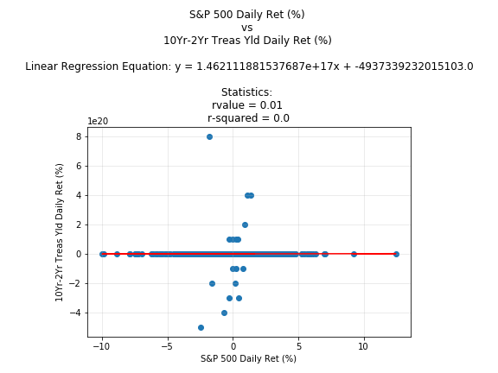

Slide 6
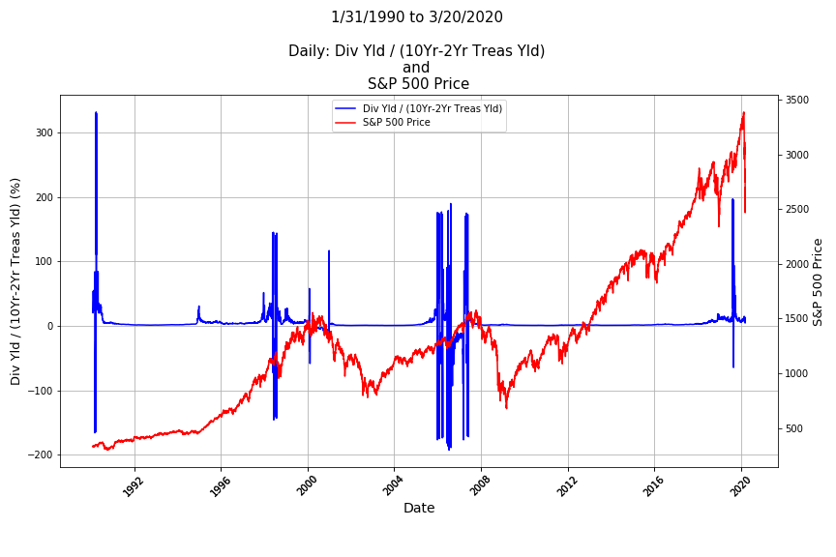

Slide 7
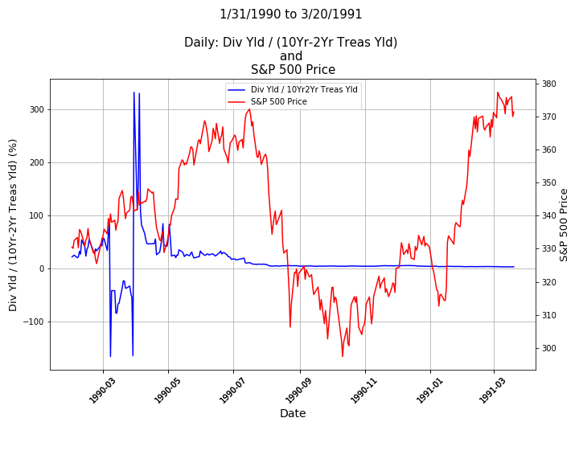
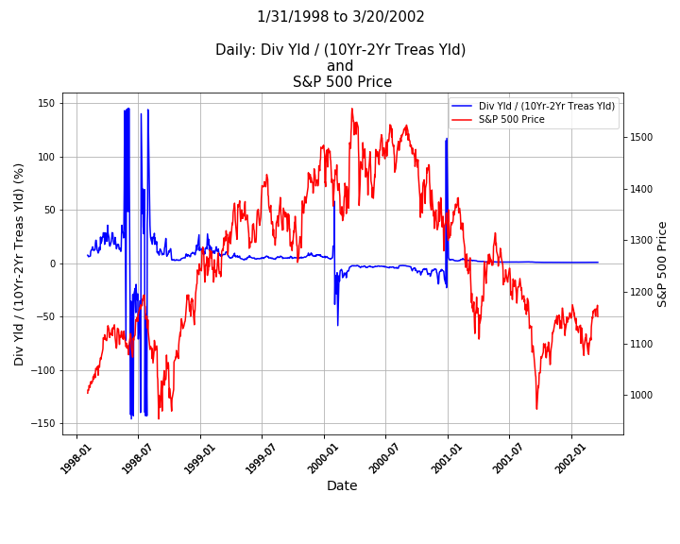

Slide 8
